Slide 1
Advanced Kubernetes Bootcamp
WLAN: MSFTGUEST
Event Code: msevent100ip
Professionalize your container enterprise

Slide 2
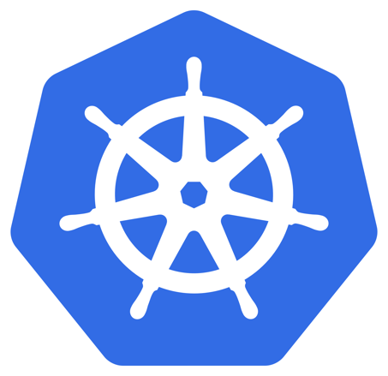
What we are going to learn...Day #1
Azure Active Directory Integration / Resource Based Access Control
Resource-Management / Scheduling
Advanced Networking / NPM / Multi-Tenancy
Advanced Ingress Configuration
K8s behind Application Gateway / Web Application Firewall
Managed Service Identity / Managed Pod Identity

Slide 3
What we are going to learn...Day #2
Sidecar Pattern
Service Mesh
Istio
„What we wanted to add…“ (Slides)

Slide 4
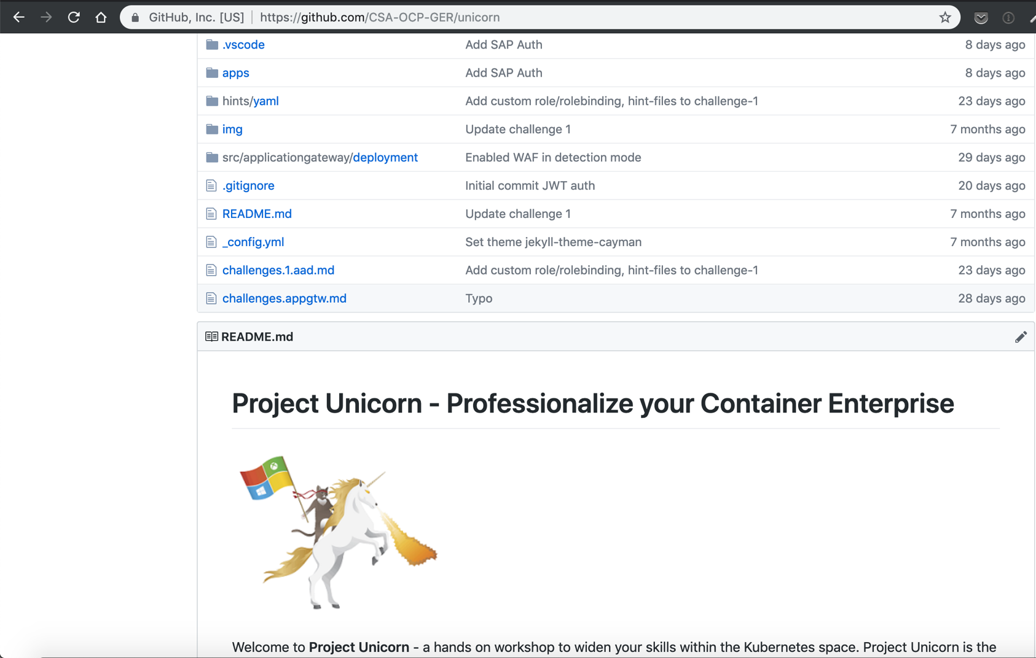
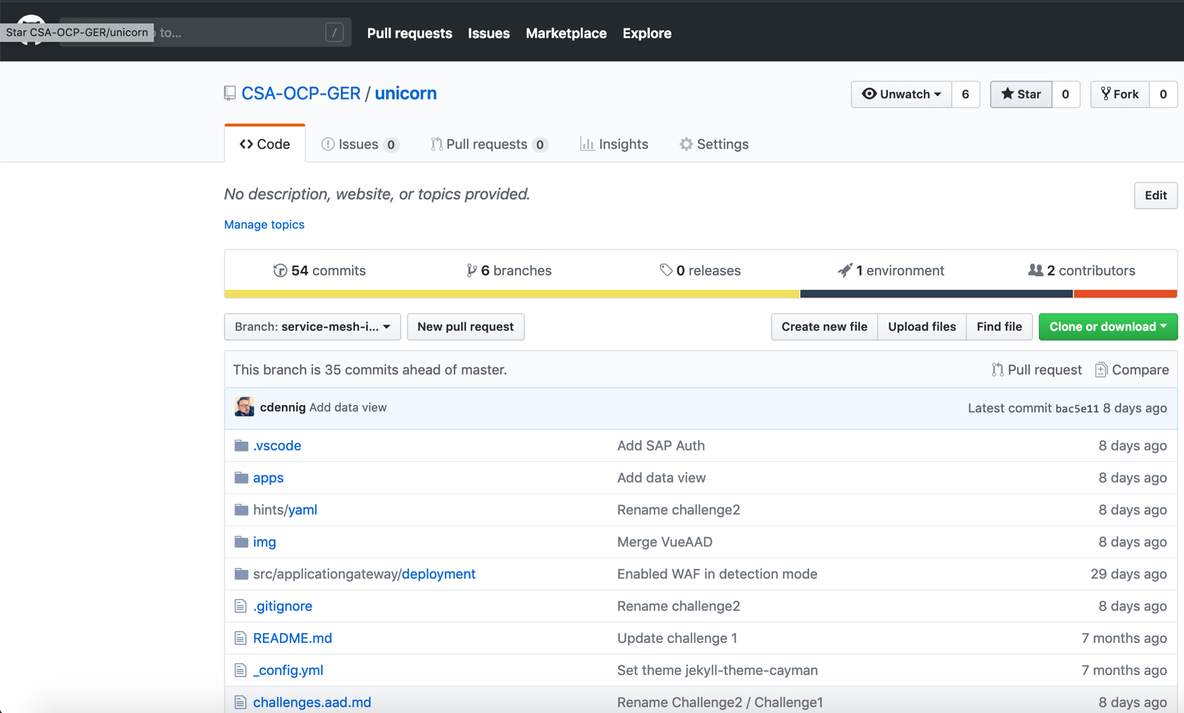
Where to find everything...?
https://github.com/CSA-OCP-GER/unicorn

Slide 5



Who we are…
Andreas Mock
Microsoft
Cloud Solutions Architect
@andreasM009
Christian Dennig
Microsoft
Cloud Solution Architect
@chrisdennig

Slide 6

Who are we dealing with...?

Slide 7


Feedback is welcome... https://aka.ms/aks-oct18hh-fb

Slide 8
The Challenges

Slide 9
Project Unicorn
Kubernetes AAD Integration / Resource Based Access Control

Slide 10
AAD Integration
Kubernetes can be configured to use AAD for user access
Authentication is provided via OpenID Connect (AAD token)
Can be enabled during cluster creation
In combination with K8s RBAC, users and groups in AAD can be allowed to access resources in your cluster

Slide 11

Cluster Level - Identity and Access Management through AAD and RBAC
Kubernetes Developer authenticates with AAD
The AAD token issuance endpoint issues the access token
Azure Active Directory
Developer performs action w/ AAD token. Eg. kubectl create pod
1
4
<\>
Token
2
Kubernetes validates token with AAD and fetches the Developer’s AAD Groups Eg. Dev Team A, App Group B
Developer
3
AKS
5
Kubernetes RBAC and cluster policies are applied
6
Request is successful or not based on the previous validation

Slide 12


Azure Level - Identity and Access Management through AAD and RBAC
Kubernetes Administrator
Kubernetes Administrator authenticates with AAD
1
The AAD token issuance endpoint issues the access token
Azure Active Directory
Token
2
Administrator fetches the admin kubeconfig and configures RBAC roles and bindings
3
<\>
Token
Kubernetes Developer fetches the user kubeconfig
Developer
AKS
4

Slide 13
Roles / Role-Bindings
Setting up a Cluster Role
Bind the Cluster Role to a user
apiVersion: rbac.authorization.k8s.io/v1beta1
kind: ClusterRole
metadata:
labels:
kubernetes.io/cluster-service: "true"
name: cluster-admin
rules:
- apiGroups:
- extensions
- apps
resources:
- deployments
verbs:
- get
- list
- watch
- update
- patch
- apiGroups:
- ""
resources:
- events
- namespaces
- nodes
- pods
verbs:
- get
- list
- watch
apiVersion: rbac.authorization.k8s.io/v1
kind: ClusterRoleBinding
metadata:
name: contoso-cluster-admins
roleRef:
apiGroup: rbac.authorization.k8s.io
kind: ClusterRole
name: cluster-admin
subjects:
- apiGroup: rbac.authorization.k8s.io
kind: User
name: "user@contoso.com"
Bind the Cluster Role to a group
apiVersion: rbac.authorization.k8s.io/v1
kind: ClusterRoleBinding
metadata:
name: contoso-cluster-admins
roleRef:
apiGroup: rbac.authorization.k8s.io
kind: ClusterRole
name: cluster-admin
subjects:
- apiGroup: rbac.authorization.k8s.io
kind: Group
name: "894656e1-39f8-4bfe-b16a-510f61af6f41"

Slide 14
Provisioning AD-enabled AKS
$ az aks get-credentials --resource-group myAKSCluster --name myAKSCluster
$ kubectl get nodes
To sign in, use a web browser to open the page https://microsoft.com/devicelogin and enter the code BUJHWDGNL to authenticate.
NAME STATUS ROLES AGE VERSION
aks-nodepool1-42032720-0 Ready agent 1h v1.9.6
aks-nodepool1-42032720-1 Ready agent 1h v1.9.6
aks-nodepool1-42032720-2 Ready agent 1h v1.9.6
Or
Error from server (Forbidden): nodes is forbidden: User baduser@contoso.com cannot list nodes at the cluster scope

Slide 15
Challenge
Azure Active Directory
create an AAD application for the API server and kubectl client
create an AAD group that will have the users allowed to login to the cluster
Kubernetes
create a cluster with RBAC and AAD integration
bind cluster roles to AAD groups
get admin credentials for the cluster
login with an AAD user

Slide 16
Project Unicorn
Advanced Scheduling / Resource Management

Slide 17
Kubernetes Scheduling
At the fundamental level, K8s is a resource manager
Scheduler of K8s is responsible of allocating pods to nodes of a cluster
Process of “finding the right node” can be influenced
Hard / soft requirements
Label-based picking of nodes
Based on running pods
Based on resource requests
etc...
Node Affinity / Taints/Tolerations
Pod Affinity / Anti-Affinity
Pod Priorities
Resource Requests

Slide 18
Kubernetes Scheduling / Priorities
Priorities indicate the importance of a workload
Relative to other pods
PriorityClass objects define how important a pod is for your application
Pods with a higher priority will be scheduled, although resources may be low
Pods with a lower priority will/can be evicted by the scheduler

Slide 19
Kubernetes Scheduling / Resource Requests + Limits
Tell the scheduler how many resources your pod will need
Find the right node for a pod
Limit the maximum amount of resources a pod can consume
Pods can be killed, e.g. if memory limits are exceeded
Can be set on pod- and namespace level
Very important in production environments: pods can “go crazy” and compromise the stability of a whole cluster!

Slide 20
Kubernetes Scheduling / HPA
Horizontal Pod Autoscaler scales the number of pods
Based on metrics like CPU / memory consumption
Can be custom metrics
HPA continuously checks metrics values
Check interval default: 30s
Attempts to increase the number of pods if specified threshold is met
Updates the number of replicas in a deployment (which is then responsible for the rollout of the changes)

Slide 21
Challenge
Kubernetes Scheduling
How does it work?
…and how to influence scheduling
Node Affinity / Pod Affinity / Anti-Affinity
Where to (not) schedule pods?
Pod Priority
What are the important workloads?
What pods should always run?
Resource Limits / Requests
Horizontal Scaling
Keep services / applications responsive

Slide 22
Project Unicorn
Advanced Networking / NPM / Multi-Tenancy

Slide 23
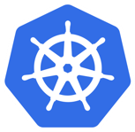
Cluster Isolation Patterns: Physical Isolation
Dev Cluster
Staging Cluster
Node0
Node1
Node0
Node1
PodA
PodB
PodE
PodF
PodA
PodB
PodE
PodF
PodC
PodD
PodG
PodH
PodC
PodD
PodG
PodH
Prod Team1 Cluster
Prod Team2 Cluster
Node0
Node1
Node0
Node1
PodA
PodB
PodE
PodF
PodA
PodB
PodE
PodF
PodC
PodD
PodG
PodH
PodC
PodD
PodG
PodH

Slide 24
Cluster Isolation Patterns: Logical Isolation
Dev and Staging Cluster
Prod Cluster
Node0
Node1
Node0
Node1
DevTeam1
Team1
Pod
Pod
Pod
Pod
Pod
Pod
Pod
Pod
Pod
Pod
Pod
Pod
Staging
Pod
Pod
Pod
Pod
Team2
Node2
Node3
Node3
Node4
Pod
Pod
Pod
Pod
Pod
Pod
Pod
Pod
Pod
Pod
Pod
Pod
DevTeam2
Pod
Pod
Pod
Pod
Team3

Slide 25
Physical vs. Logical Isolation
Physical
Logical
Pod Density
Low to Medium
Medium to High
Cost
$$
$
Kubernetes Experience
Low to Medium
Medium to High
Security
High (Surface is small)
High*
Blast Radius of Changes
Small
Big
Management and Operations
Owner Team
Single or Cross Functional Team
*Logical Isolation via Namespaces can achieve hard isolation assuming the cluster admin has applied all the required security controls

Slide 26
Kubernetes Namespaces
Namespace Object is the logical Isolation boundary
Kubernetes has features to help us safely isolate tenants
Scheduling: Resource Quota
Network Isolation using Network Policies
Authentication and Authorization: RBAC and Pod Security Policy

Slide 27
Azure Network Policy Manager
Microsoft’s own network policy module
Implements Kubernetes Network Policies for aks-engine / Azure Kubernetes Service
Depends on Azure CNI / “Advanced Networking” feature
Apply networking rules on pods / namespaces, e.g. deny / allow traffic to certain pods
Follows LIFO principle
e.g. deploy a “deny-inbound-all” rule to a namespace first, then deploy additional policies to allow access as necessary
Network Policy Recipes: https://github.com/ahmetb/kubernetes-network-policy-recipes

Slide 28
Project Calico
Calico is a “battle-proof” open source networking and network security solution
Can be used with “Basic” (kubenet) and “Advanced Networking” (Azure CNI)
Supports a broad range of platforms including:
Kubernetes
OpenShift
Docker EE
OpenStack
bare metal services etc.
Full NetworkPolicy support on Kubernetes

Slide 29
Challenge
Get to know logical isolation pattern
Apply NetworkPolicies to isolate workloads on one Kubernetes cluster
You can choose between NPM and Calico

Slide 30
Project Unicorn
Advanced Ingress Configuration

Slide 31
Ingress
North/South traffic? Ingress controller is your friend!
Use LoadBalancer service type as seldom as possible
NGINX is a widely used solution
There are (of course) others
Ambassador
Traeffik
Contour / Envoy
Kong
…
For APIs: use an API Gateway
Azure API Management (→ outside the cluster. Use a combination of Azure CNI and internal loadbalancers)
Kong
Express Gateway
…

Slide 32

Ingress
Traffic
Azure Load Balancer
Public IP Address for
Ingress Controller
Kubernetes Cluster
Ingress
https://foo.example.com
https://example.com/bar
Service
Service
Pod
Pod
Pod
Pod
Pod
Pod

Slide 33
Challenge
Deploy an NGINX ingress controller
Define ingress rules
IP Whitelisting to limit access to certain applications
Achieve rate limiting with an ingress controller
Enable Basic Auth
Bonus: Delegate Authentication to Azure Active Directory and learn how to integrate Let's Encrypt (SSL certificates)

Slide 34
Project Unicorn
K8s behind Application Gateway / Web Application Firewall

Slide 35
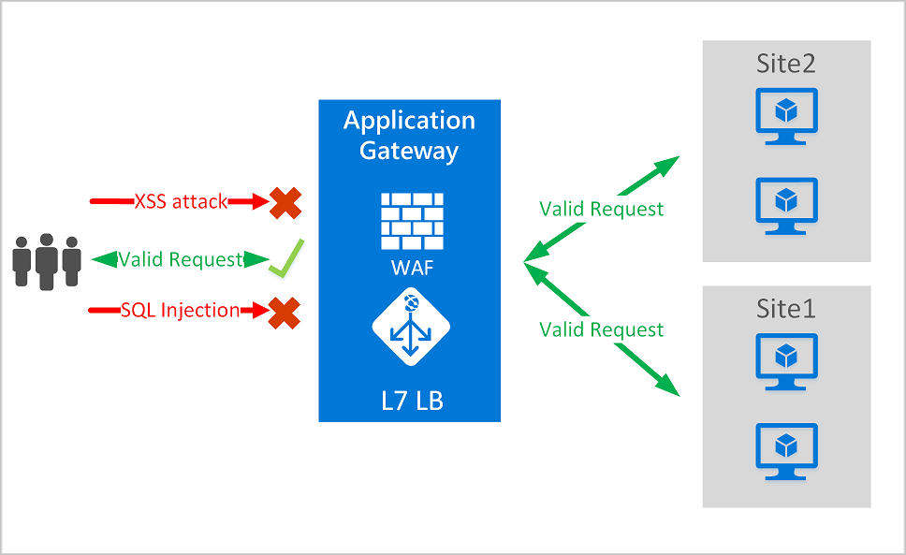
Securing Kubernetes Services with WAF
Web Application Firewall is a feature of Application Gateway that provides centralized protection of your web applications from common exploits and vulnerabilities.
WAF is based on rules from the OWASP core rule sets 3.0 or 2.2.9. It automatically updates to include protection against new vulnerabilities, with no additional configuration needed.

Slide 36
WAF Features
SQL injection protection
Cross site scripting protection
Common Web Attacks Protection such as command injection, HTTP request smuggling, HTTP response splitting, and remote file inclusion attack
Protection against HTTP protocol violations
Protection against HTTP protocol anomalies such as missing host user-agent and accept headers
Prevention against bots, crawlers, and scanners
Detection of common application misconfigurations (for example, Apache, IIS, and so on)
Request size limits - Web Application Firewall allows users to configure request size limits within lower and upper bounds.
Exclusion lists - WAF exclusion lists allow users to omit certain request attributes from a WAF evaluation. A common example is Active Directory inserted tokens that are used for authentication or password fields.

Slide 37



Public Service
Service Type LoadBalancer
Basic Layer4 Load Balancing (TCP/UDP)
Each service as assigned an IP on the ALB
Azure AKS VNet
Public IP
apiVersion: v1
kind: Service
metadata:
name: frontendservice
spec:
loadBalancerIP: X.X.X.X
type: LoadBalancer
ports:
- port: 80
selector:
app: frontend
Public LB
AKS subnet
AKS cluster
FrontEndService
Pod1 label:Frontend
Pod2 label:Frontend
Pod3 label:Frontend

Slide 38
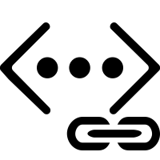


Internal Service
VNet B
On-premises infrastructure
Other peered VNets
Enterprise system
Used for internal services that should be accessed by other VNETs or On-Premise only
VNet peering
Azure Express Route
apiVersion: v1
kind: Service
metadata:
name: internalservice
annotations:
service.beta.kubernetes.io/azure-load-balancer-internal: "true"
spec:
type: LoadBalancer loadBalancerIP: 10.240.0.25
ports:
- port: 80
selector:
app: internal
Azure AKS VNet
Internal IP
Internal LB
AKS subnet
AKS cluster
InternalService
Pod1 label:Internal
Pod2 label:Internal
Pod3 label:Internal

Slide 39


Securing Kubernetes Services with WAF (Basic Networking)
Azure Management VNET
APP GW Subnet
Azure AKS VNet
VNet peering
Private IP
AKS subnet
Internal LB
AKS cluster
Ingress
contoso.com/A
contoso.com/B
service.contoso.com
ServiceA
ServiceB
ServiceC

Slide 40

Securing Kubernetes Services with WAF
(Advanced Networking)
VNet
Puplic IP
Private IP
AKS subnet
Internal LB
APP GW Subnet
AKS cluster
Ingress
contoso.com/A
contoso.com/B
service.contoso.com
ServiceA
ServiceB
ServiceC

Slide 41
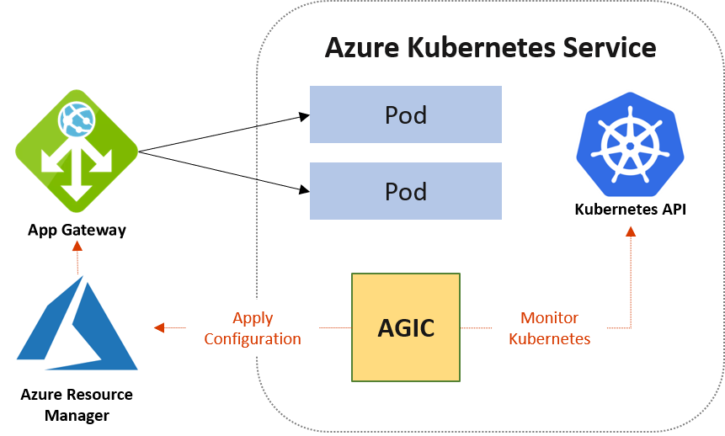
Application Gateway Ingress
https://azure.github.io/application-gateway-kubernetes-ingress/

Slide 42
Challenge
Secure your Cluster with ApplicationGateway WAF
create an ApplicationGateway with WAF enabled
route traffic from public ApplicationGateway to your Cluster's internal LoadBalancer
Cluster
create a Cluster with Azure Advanced Container Network Integration (Azure CNI)
create an internal ingress controller
deploy your cluster with Azure ARM Templates
create a service principal for Kubernetes to manage Azure resources

Slide 43
Project Unicorn
Managed Service Identity / Managed Pod Identity

Slide 44
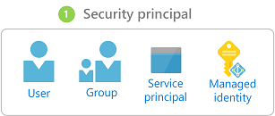
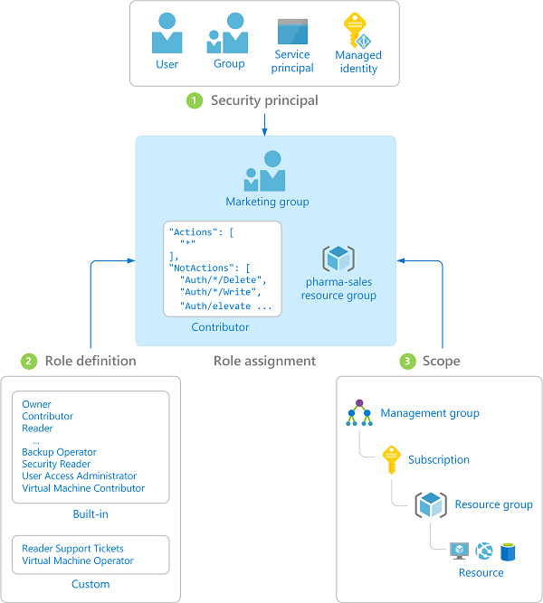
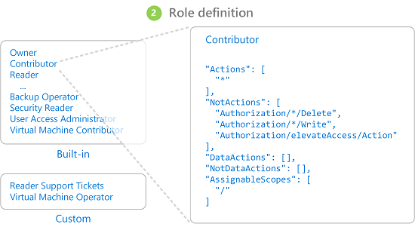
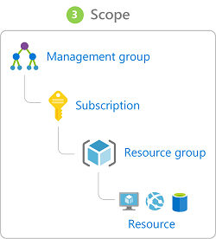
Azure RBAC

Slide 45
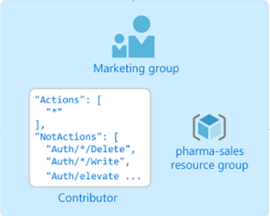



Access Azure Resources in your workload
Role assignment
Your workload uses a Service Principal to get an access token to invoke the Azure Resource Manager API.
You have to store the Service Principal Id and key credentials in your app settings or similar.
You need to do a rolling update for your key credential when it expires.
uses
accesses
Workload
Resource

Slide 46
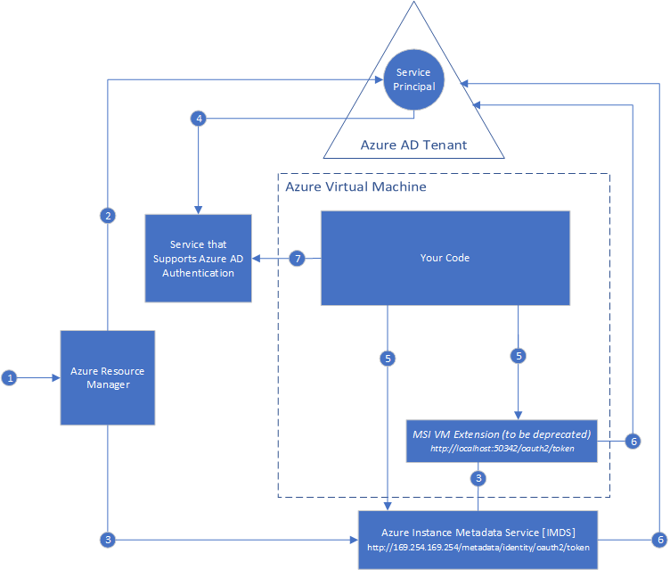
Managed Service Identity MSI
System-assigned managed identity
User-assigned managed identity
https://docs.microsoft.com/en-us/azure/active-directory/managed-identities-azure-resources/overview

Slide 47
AAD Pod Identity
apiVersion: "aadpodidentity.k8s.io/v1"
kind: AzureIdentity
metadata:
name: demoidentity
spec:
type: 0
ResourceID: <resource-id>
ClientID: <ClientID>
1
Service Principal
AAD Tenant
AKS cluster
2
Node VM
Service that supports AAD Authentication
Pod
MIC
apiVersion: "aadpodidentity.k8s.io/v1"
kind: AzureIdentityBinding
metadata:
name: demo1-azure-identity-binding
spec:
AzureIdentity: demoidentity
Selector: azureidentitydemo
5
Manges pod to identity mappings
3
Azure Resource Manager
Requests token 169.254.169.254
queries mapping
1
NMI
3
route
User-assigned Identity
redirect
apiVersion: extensions/v1beta1
kind: Deployment
metadata:
name: aadpodidentitydemoapibackend
spec:
template:
metadata:
labels:
name: aadpodidentitydemoapibackend
app: aadpodidentitydemoapi
aadpodidbinding: azureidentitydemo
1
2
4
Token request with identity id
MIC assigns identity to VM where pod is running
Azure Instance Metadata Service [IMDS]
http://169.254.169.254/metadata/identity/oauth2/token
3

Slide 48
Challenge
Create a user-assigned managed identity
Install aad-pod-identity in your cluster
Create an Azure Key Vault and store credentials
Deploy a pod that uses a user-assigned managed identity to access an Azure Key Vault

Slide 49
Project Unicorn
Sidecar Pattern

Slide 50
Sidecar Pattern
Pod
App Container
Sidecar
Pod with multiple containers
Containers can communicate in the pod
Writing to a shared file or directory
Inter-process communication (semaphores, shared memory)
Sockets
Message Queues
Use cases:
Reverse-Proxy
Caching
Logging
Authentication and Authorization
Writes log files
Sends logfiles to common storage
Pod has shared filesystem
apiVersion: extensions/v1beta1
kind: Deployment
metadata:
name: sidecardemoapibackend
spec:
template:
metadata:
labels:
name: sidecardemoapibackend
app: sidecar
spec:
containers:
- name: sidecarproxy
image: <registry>.azurecr.io/sidecarproxy:1.0
ports:
- containerPort: 8080
name: http
protocol: TCP
- name: demoapi
image: <registry>.azurecr.io/sidecardemoapi:1.0

Slide 51
Challenge
Create a deployment with an additional container that acts as proxy for your API
Your API should only be accessible via the proxy

Slide 52
Project Unicorn
Service Mesh / Istio

Slide 53

Istio
Service Mesh with features and functions for creating and managing microservices
Greek word for “sail”
Adds…”fleet management”:
Monitoring
Tracing
Circuit Breakers
Sophisticated Request Routing (A/B testing, Canary Releases etc.)
Advanced Load-Balancing
Fault Injection
Retry mechanisms
Request Mirroring
Access Control / Authorization / TLS
Rate Limiting
Ingress/egress Gateway
…
Runs as a sidecar in your pods / automatic injection during deployment
No code changes required (you can rather get rid of a lot of code!)

Slide 54
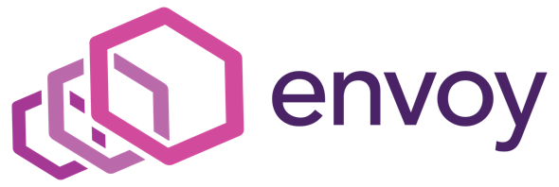
Istio / Envoy
Service proxy implementation by Lyft
Highly parallel, non-blocking
L3/4 network filter
Out-of-the-box L7 filters
HTTP/2, gRCP
Service discovery + health checking
Advanced load balancing

Slide 55
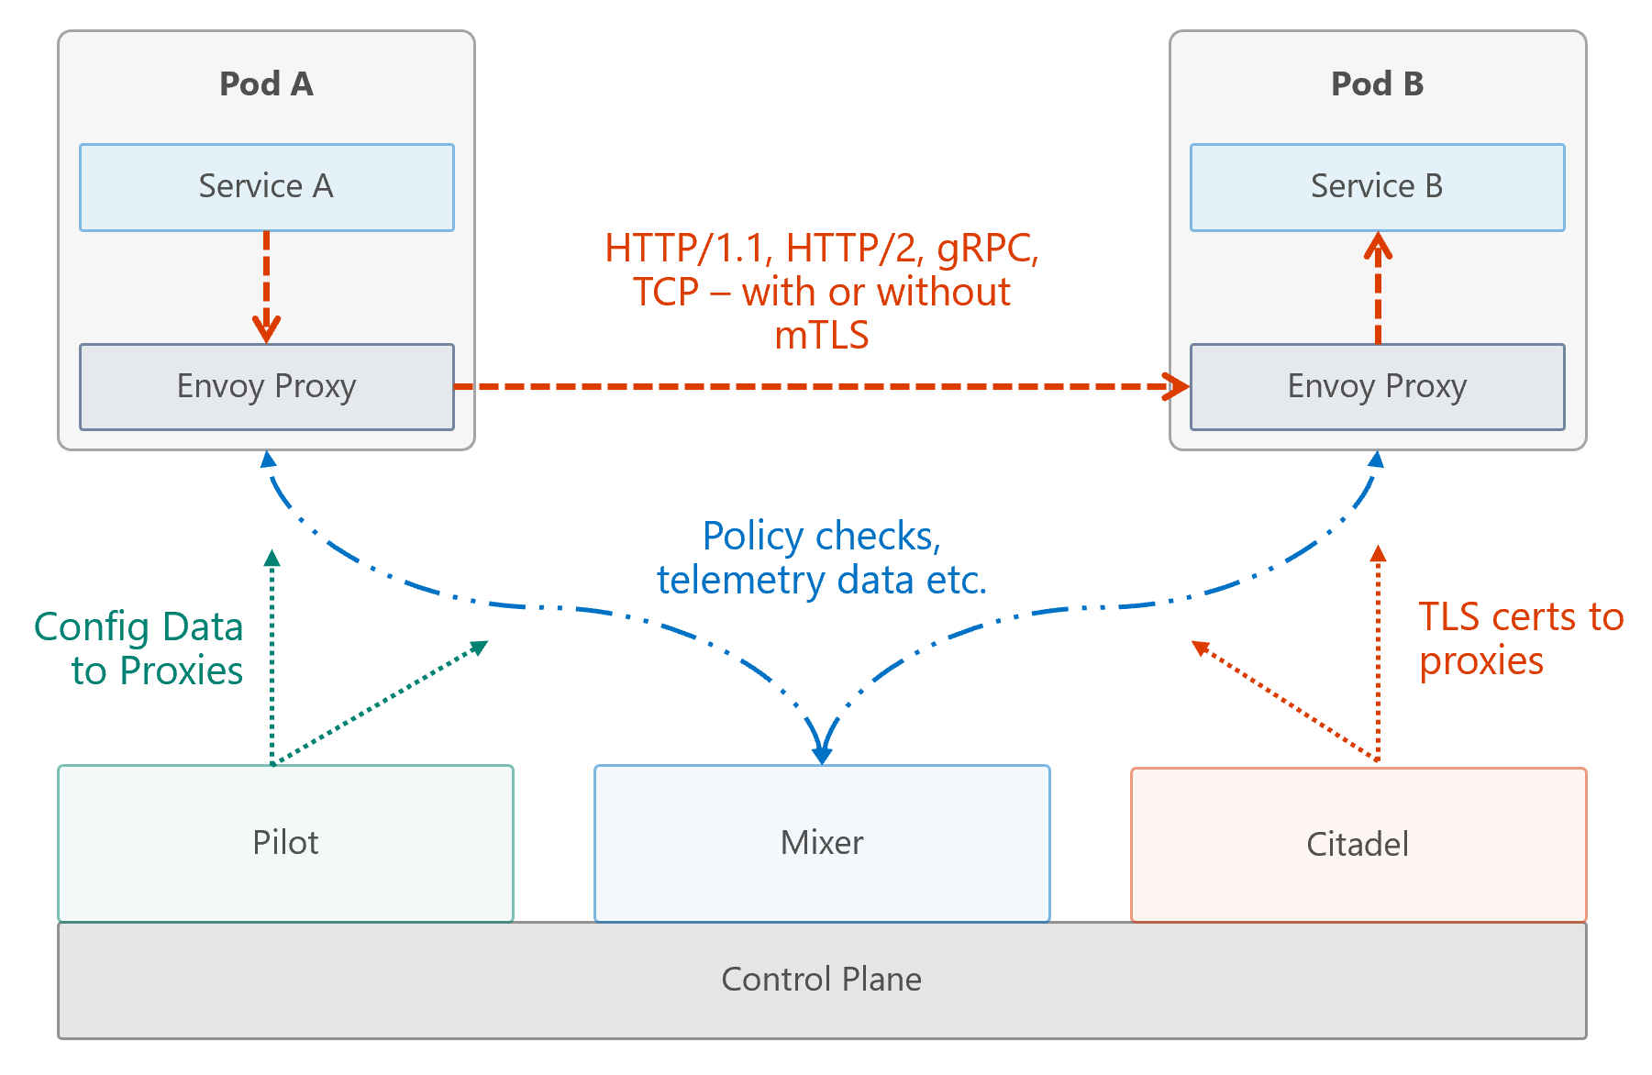
Istio
Pilot
Configures proxies
Provides service discovery
Traffic management
Resiliency
Mixer
Enforces access-control / policy checks
Collects telemetry data
Evaluates request attributes like path, size, destination etc. for every request
Citadel
Service-to-service / end-user authentication
Credential / cert management
Galley
Configuration validation / processing / distribution
Isolates Istio from underlying platform

Slide 56
Challenge
Get familiar with Istio
Install Istio into your AKS cluster ️
Configure ingress routes and request routing
Implement the Circuit Breaker pattern
Gain insights about your applications routes
Play with fault injection to challenge your services
Test new service versions with request mirroring

Slide 57
Continuous Integration / Deployment with Azure DevOps Pipelines

Slide 58
How to organize code for micro-services?
Multiple repositories
Pros:
Clear Ownership
Smaller code base
Narrow clones
Cons:
Difficult development and debugging
Abstracts the knowledge of a platform
Single repository
Pros:
Better development and debugging
Easy refactoring and reviews
Cons:
Larger code base
Greater clone time
Use a single repository when you only have one team, otherwise use multiple repositories.

Slide 59
“What we wanted to add…”

Slide 60
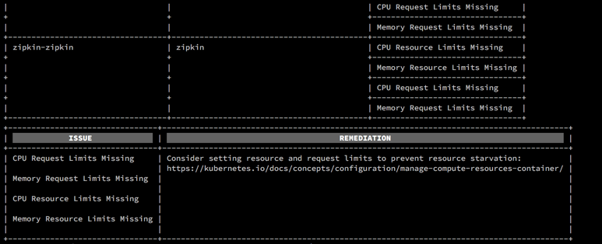
Kube-advisor
Diagnostic tool for Kubernetes clusters. At the moment, it returns pods that are missing resource and request limits.
More info can be found at https://github.com/Azure/kube-advisor

Slide 61
Cluster Level Security – Nodes, Upgrade and Patches
Regular maintenance, security and cleanup tasks
Maintain, update and upgrade hosts and kubernetes
Monthly ideal, 3 months minimum
Security patches
AKS automatically applies security patches to the nodes on a nightly schedule
You’re responsible to reboot as required
Kured DaemonSet https://github.com/weaveworks/kured
Upgrade to version current version
$ az aks upgrade --name myAKSCluster \ --resource-group myResourceGroup \ --kubernetes-version x.y.z
Running benchmarks and tests to validate cluster setup
Kube-bench / https://github.com/aquasecurity/kube-bench
Kube Hunter (active/passive – so be careful!) / https://github.com/aquasecurity/kube-hunter/
Others

Slide 62






Container Level Security – Images
Scan your images, scan your containers
Aqua and Twistlock container security
Helm chart
AKS production cluster
Web tier
Inner loop
Azure Container Registry
Source code control
Azure Monitor
VSCode
AKS dev cluster
Test
Aqua, Twistlock, Neuvector Container Security
Debug
Business tier
Auto-build
Azure Pipelines/ DevOps Project
Database tier
CI/CD

Slide 63
Pod Level – Pod Security Context
apiVersion: v1 kind: Pod metadata: name: security-context-demo spec: securityContext: runAsUser: 1000 fsGroup: 2000 volumes: - name: sec-ctx-vol emptyDir: {} containers: - name: sec-ctx-demo image: ignite.azurecr.io/nginx-demo volumeMounts: - name: sec-ctx-vol mountPath: /data/demo securityContext: runAsUser: 2000 allowPrivilegeEscalation: false capabilities: add: ["NET_ADMIN", "SYS_TIME"] seLinuxOptions: level: "s0:c123,c456"

Slide 64
Pod Level – Pod Security Context
apiVersion: v1 kind: Pod metadata: name: security-context-demo spec: securityContext: runAsUser: 1000 fsGroup: 2000 volumes: - name: sec-ctx-vol emptyDir: {} containers: - name: sec-ctx-demo image: ignite.azurecr.io/nginx-demo volumeMounts: - name: sec-ctx-vol mountPath: /data/demo securityContext: runAsUser: 2000 allowPrivilegeEscalation: false capabilities: add: ["NET_ADMIN", "SYS_TIME"] seLinuxOptions: level: "s0:c123,c456"

Slide 65
Pod Level – Pod Security Policies
apiVersion: policy/v1beta1 kind: PodSecurityPolicy metadata: name: restricted annotations: seccomp.security.alpha.kubernetes.io/allowedProfileNames: 'docker/default’ apparmor.security.beta.kubernetes.io/allowedProfileNames: 'runtime/default’ seccomp.security.alpha.kubernetes.io/defaultProfileName: 'docker/default’ apparmor.security.beta.kubernetes.io/defaultProfileName: 'runtime/default’ spec: privileged: false allowPrivilegeEscalation: false # Required to prevent escalations to root. requiredDropCapabilities: # This is redundant with non-root + disallow privilege escalation, but we can provide it for defense in depth. - ALL volumes: # Allow core volume types. - 'configMap’ - 'emptyDir’ - 'projected’ - 'secret’ - 'downwardAPI’ - 'persistentVolumeClaim’ # Assume that persistentVolumes set up by the cluster admin are safe to use. hostNetwork: false hostIPC: false hostPID: false runAsUser: rule: 'MustRunAsNonRoot’ # Require the container to run without root privileges. seLinux: rule: 'RunAsAny’ # This policy assumes the nodes are using AppArmor rather than SELinux. supplementalGroups: rule: 'MustRunAs’ ranges: - min: 1 # Forbid adding the root group. max: 65535 fsGroup: rule: 'MustRunAs’ ranges: - min: 1 # Forbid adding the root group. max: 65535 readOnlyRootFilesystem: false

Slide 66

Cluster Autoscaler
Scales nodes based on pending pods
Scale up and scale down
Reduces dependency on monitoring
Removes need for users to manage nodes and monitor service usage manually
Additional node(s) needed
CA
Pods are in pending state
Pod
Pod
Node is granted
Pending pods are scheduled
Node
Node
Pod
Pod
Pod
Pod
AKS Cluster

Slide 67
Bursting with the ACI Connector/ Virtual Kubelet
VM
VM
Pods
Pods
Azure Container Instances (ACI)
Application Architect
Pods
Kubernetes control pane
Infrastructure Architect
Deployment/tasks
ACI Connector
VM
VM
Pods
Pods

Slide 68

Multi-Region Clusters
Minimize downtime risk
One live region
Another backup
Or weighted traffic
A/B testing
Azure Traffic Manager
AKS Cluster 1 Region 1
AKS Cluster 2 Region 2
Azure paired regions

